Slide 1








R E V I E W :
Addition & Subtraction
with 2-digit numbers

Slide 2








A. 102
B. 110
74 + 28 = ?
C. 46
D. 92

Slide 3





A. 102

Slide 4









92 - 37 = ?
A. 102
C. 55
B. 110
D. 92

Slide 5





C. 55

Slide 6




A. 125
B. 43
84 - 41 = ?
C. 40
D. 45

Slide 7





B. 43

Slide 8

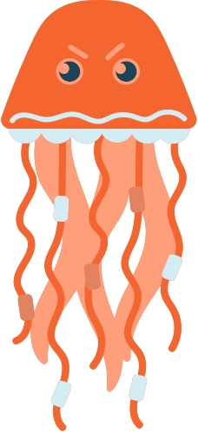





A tank at the aquarium has 45 clownfish and 27 angelfish. How many fish are in the tank altogether?
KEY WORD: TOGETHER
(ADD)
A. 62 fish
C. 72 fish
B. 80 fish
D. 18 fish

Slide 9







B. 72 fish

Slide 10







A. 15 shells
A deep sea diver is collecting seashells. She finds 68 shells and wants to give them as gifts. She gives 53 away. How many shells does she have left?
B. 5 shells
C. 121 shells
A. 20 shells

Slide 11




A. 15 shells

Slide 12










Congratulations!
Review complete!

